Slide 1

MatchUp Overview

Slide 2





Introduction
MatchUp is used to compare database records and determine if duplicate records exist.
MatchUp is offered as…
A stand-alone Windows software solution
A programmers API
An Enterprise level ETL solution: SSIS , Pentaho components
A Web Service
An Excel Plug-In

Slide 3






Introduction: MatchUp got started partly because of this problem – too much mail!

Slide 4

NAME | ADDRESS | CSZ | PHONE | EMAIL
Mary Smith MD | 12 Main Street | Anytown, CA 99999 | 999-999-2000
John Smith Jr | 12 Main St | Anytown, CA 99999 | 555-444-1234 | john@smithhouse.com
John L Smith DDS | Twelve Main St | Anytown, CA 99999 | 555-444-1234
Mr John Smith Jr | 12 Main St | Anytown, CA 99999 |  | john@work.com
John Smith Jr | 12 Main St | Anytown, CA 99999 | 555-444-1234
Billy Smith |  | Anytown, CA 99999 | 555-200-6666 | billy43@gaming.com
Billy Smith | 12 Main St | Anytown, CA 99999 |  | billy44@gaming.com
John Smith Jr | 12 Main St | Anytown, CA 99999 | 555-200-6666 | billy45@gaming.com
Maria Smith | 4 Campus Way, Rm 6 | Collegeville, CA 99999 | 737-115-8844 | maria@college.edu
Maria Smith | 12 Main St | Anytown, CA 99999 | 737-115-8844
Dr. Mary Smith |  | Anytown, CA 99999 | 999-999-2000 | m.smith@lab.edu
John Smith Jr | 12 Main St | Anytown, CA 99999 | 555-444-1234
Today, the problem is more like this. How did all these get in our system, and how do we resolve them?

Slide 5
Introduction
MatchUp can…
Process files with different structures, field names, types or lengths and output the results to your choice of file types or database formats. FLEXIBLE.
Process multiple matchcodes (matching criteria) in a single pass, each of which can be made of any part(s) of any field(s) you designate. UNLIMITED MATCHING
Prioritize matched records for output, and roll up data into a single record. ADVANCED.

Slide 6
Output properties necessary to distinguish duplicate records….
FULLNAME | ADDRESS | ZIP | PHONE | CODE | TOTAL | Results | Group | Count
Jeff Clareck | 18 JORDAN MILL CT | 16100 |  | B | 100 | MS01 | 1 | 1
Jeff Clarreck | 18 JORDAN MILL CT | 16100 |  | AU | 50 | MS01 | 2 | 1
Mr. Charles N. Lee Sr. | 5773 N Oyster Rd # 5 | 54229 | 781545-7300 | IRA | 500 | MS02,MS06 | 3 | 3
Mr Charles Lee Jr Phd. | 5773 N Oyster Rd Apt 5 | 54229 | 800-212-7300 | IRA | 46 | MS03,MS06 | 3 | 3
Charles Lee | 5773 North Oyster Rd | 54229 | 216.949.4000 | S | 1000 | MS03,MS06 | 3 | 3
Chuck Lee | 5700 N Oyster Rd | 54229 | 781545-7300 | CHK | 500 | MS01 | 4 | 1
Jo Tennison Sr | 1033 Bush Ave | 07452 | 622-545-7000 | IRA | 244 | MS02,MS06 | 5 | 2
Jo Tennison Jr | 1033 Bush Ave | 07452 | 781545-7000 | S | 77 | MS03,MS06 | 5 | 2
Darlene Terry | PO BOX 7 | 92688 | 981545-7343 | STOCK | 880 | MS01 | 6 | 1
Dusty Terry | PO BOX 7 | 92688 | 981-545-7666 | CHK | 100 | MS01 | 7 | 1
Sam Smith | 12 Main St | 92688 | 981-545-7344 | PROP | 40 | MS01 | 8 | 1
Samantha Smith MD | 12 Main St | 92688 | 981-545-7666 | CHK | 66 | MS01 | 9 | 1
Samuel Smith | 12 Main St | 92688 | 981-545-7344 | S | 100 | MS01 | 10 | 1

Slide 7
Identify and output golden records and gather survivorship data….

Slide 8
Or, retain all records and survivorship data….

Slide 9
Distribution Options
Choose the right solution for your needs…
 | MatchUp Windows Desktop | MatchUp Object | MatchUp ETL | LWXL MatchUp | MatchUp Web Service
Matchcode Editor | x | X | x |  | no
Programming required |  | x |  |  | x
Multi Platform |  | x
realTime - Deduping |  | X
Flexible output (File type) | Various file types |  | Various file types
Record Limit | unlimited | Unlimited | unlimited | 50000 | unlimited
Global processing? | US, CAN, UK | Global | Global | presently no | presently no
Output record Consolidation | gathering |  | survivorship
Output record priority | priority |  | golden record
source record update (distribute) | scattering
Rapid Development | x |  | x
Rapid Integration |  |  | X | x
direct file handling | x |  | x | Excel, csv, etc.
unlimited files | X |  | Source, lookup
analyzing | built in tool |  |  | x
file control toolset | x
CASS | x
Automatic reports generated | 18 reports |  |  | X
updates |  | x | x | X | automatic
support | x | x | x | x | x

Slide 10
Concepts
How does MatchUp determine if two records match? Lets take a look at a few examples of records that appear to be the same contact…
US / Canada
Query
Match
Smith Jr., John
Accounting Services, Inc.
12 Main St
Anytown, CA 92688
Mr. J Smithe
TAXman Consulting
Suite 5
12 North Main Street
Anytown, CA 92688

Slide 11
Concepts
Germany
Query
Match
Mr. J. Smithe
Deutsche Bank Ltd.
Berger Straße 130
60385
Frankfurt Am Main
Germany
Herr Jürgen Smithe
Deutsche Bank GmbH
Suite 5
Berger Str. 130
60385 Frankfurt Am Main
DEU
11

Slide 12
Concepts
United Kingdom
Query
Match
Mr. Steven Gerrard
Liverpool Football Club, LTD
Anfield Road
Liverpool
L4 0TH
Merseyside
UK
Steven George Gerrard, MBE
Liverpool Football Club
Anfield Rd
Liverpool
L4 0TH
United Kingdom
12

Slide 13
Concepts
Australia
Query
Match
Louise Herron AM CEO
Sydney Opera House
Bennelong Pt
Sydney NSW 2000
Australia
Louise Herron
Sydney Opera House
Bennelong Point
Sydney
New South Wales
2000
AUS
13

Slide 14
Concepts
MatchUp uses a records' matchkey to compare it against the keys of other records.
What's a matchkey? A string of data, extracted from each record, used to compare records. The matchcode you select, determines which data is extracted from each record to build the matchkey.
What's a matchcode? A matchcode is a set of rules which allow you to determine if two records should be considered duplicates. It contains the data types to be used, their size, order, their individual properties, and how they work in different combinations.
MatchUp uses a predefined matchcode, or one you have created using the Matchcode Editor, to create a matchkey for each record.
For a full discussion of matchcodes and matchkeys see…
Understanding Matchodes
Which is also available as: 2_MatchcodeEditor_Overview.pptx

Slide 15
Concepts
MatchUp is distributed with the ‘Matchcode Editor’, a graphic tool which allows you to determine and create rules when comparing records.

Slide 16
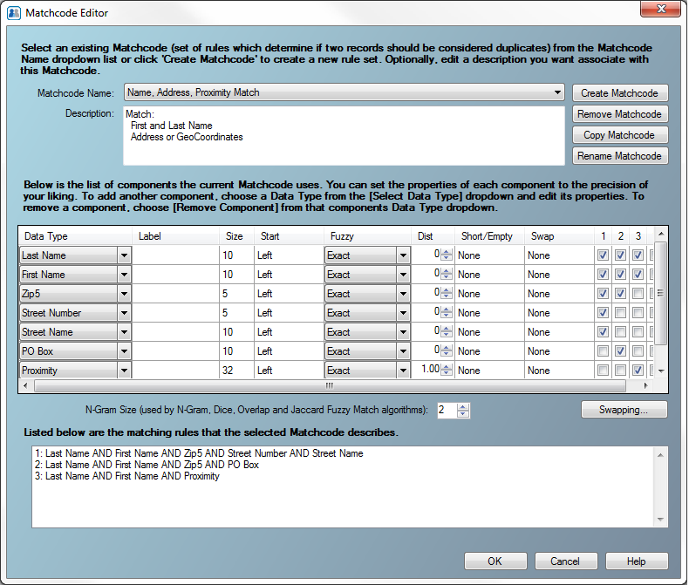
You select a distributed matching strategy (matchcode), or create a custom matchcode to suit your needs.

Slide 17
View the configured properties of distributed matchcodes, or add new ones to your custom matchcode here and configure.

Slide 18
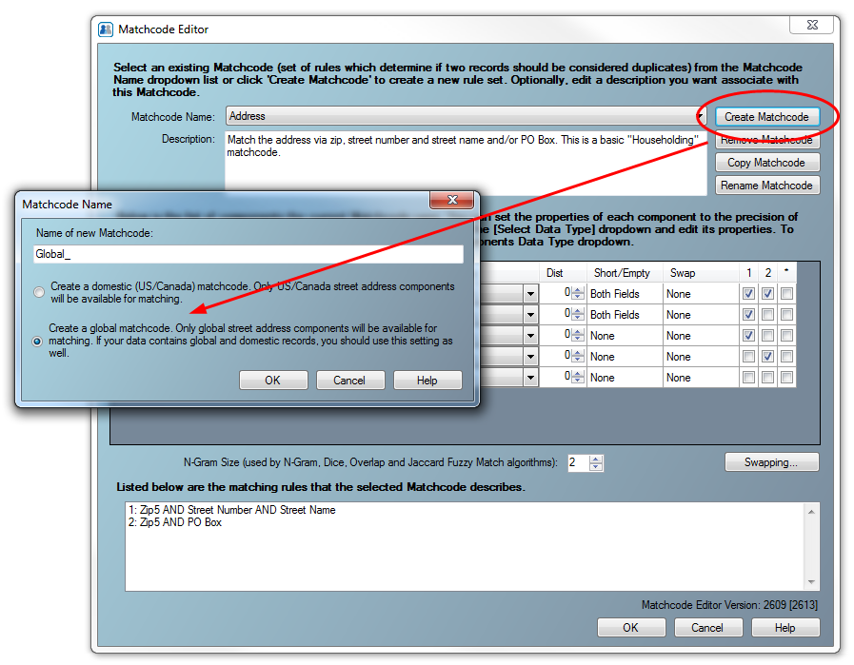
With the new Global MatchUp, you have the ability to create a global matchcode

Slide 19
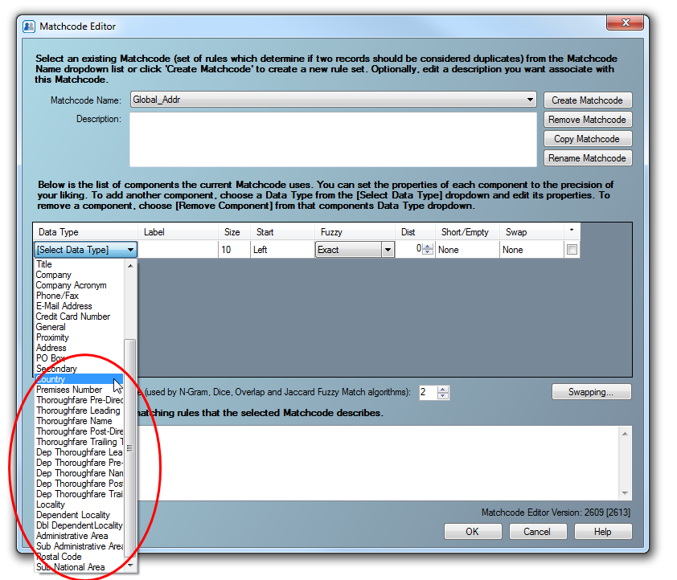
Global Matchcodes have an additional set of parsed address matchcode datatypes.
But we always add Country to a global matchcode.

Slide 20
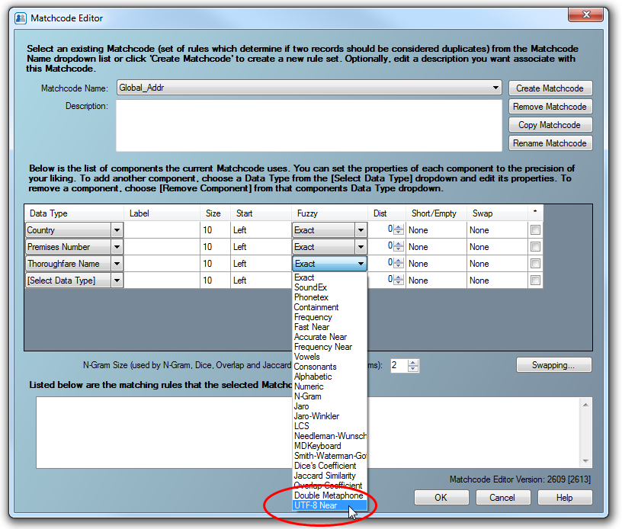
Since many of the traditional Fuzzy algorithms do not comply with extended characters, we have a new algorithm for Global data

Slide 21
Using the matchcode
For matching solutions with a GUI interface, you will simply select the matchcode to use.
For developer solutions, you will specify and configure your matchcode in your calling application code
See additional MatchUp documentation for specific order of operations.

Slide 22
Global Processing
Why the difference between Global and Domestic matchcode logic?
Global Deduping relies on our Global Address Object’s address splitter to parse the numerous possible global address patterns
Postal codes are part of the full address line input for Global, not a separate mapped datatype.

Slide 23
Global Processing
Encoding – functionality has been added so the user can specify the encoding of the database
Country specific matching – MatchUp relies on the GlobalAddress Object for Address parsing (but does not verify the address. This requires Country to be one of the matchcode components.
Knowledgebase – we are carefully adding datatype keywords to the underlying datafiles. Ex: gmBH

Slide 24
Additional Resources
Melissa Data Wiki
MatchcodeEditor_Overview.pptx
InefficientMatchcode_Analysis.pptx
EditingMatchcodes.pptx (coming)
MatchUp_GUI.pptx
MatchUp_Object.pptx
MatchUp_SSIS.pptx

Slide 25
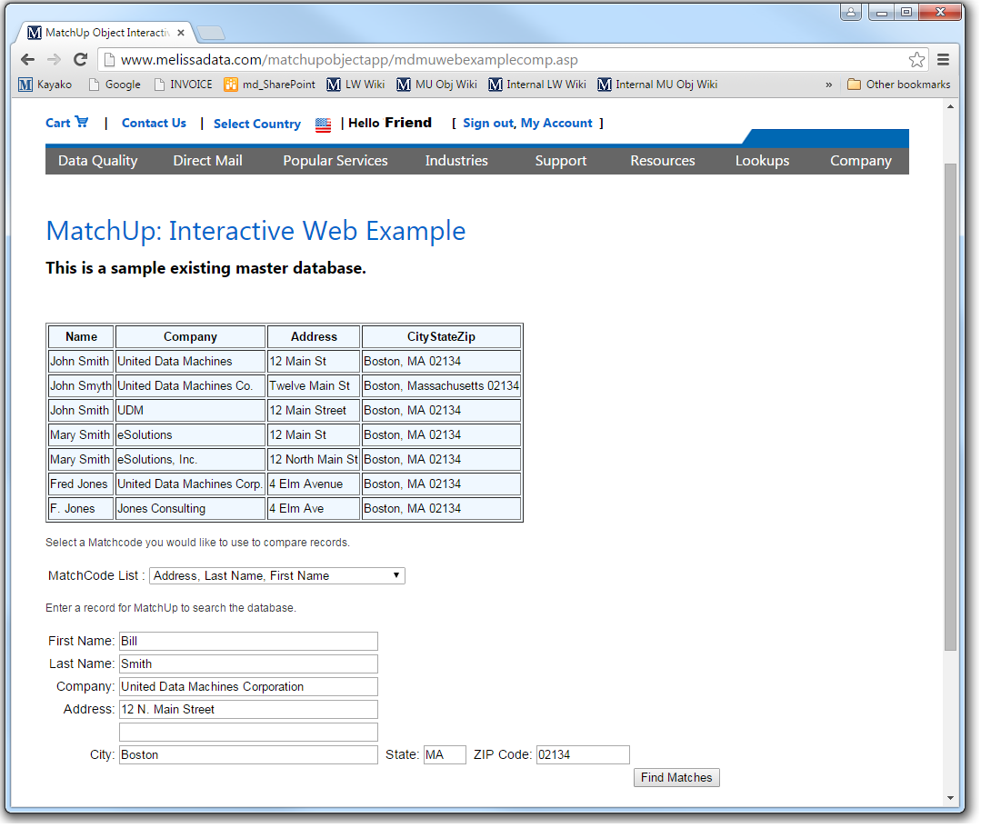
Resources
Take me to this Online example

Slide 26
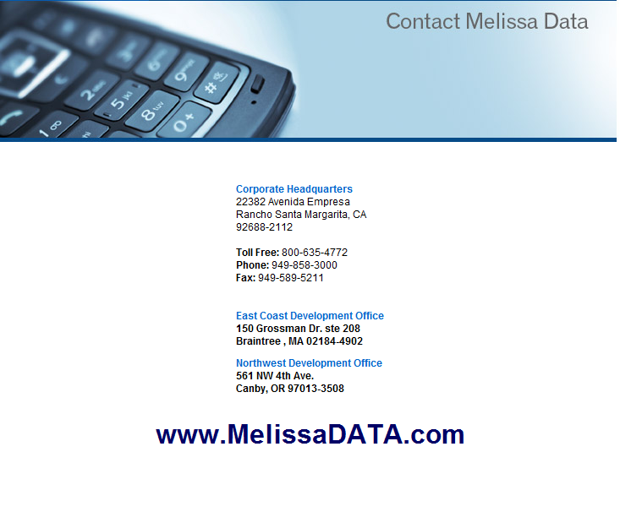

Slide 27

Thank You

