Slide 1
MatchUp Desktop

Slide 2
MatchUp
Introduction
Advanced Desktop Merge Purge

Slide 3
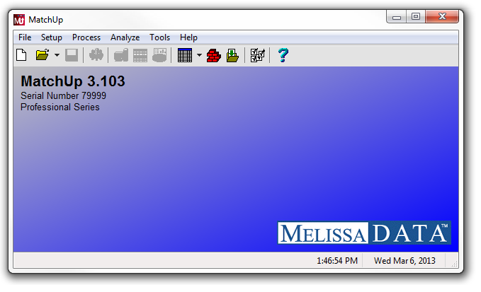
Setting up a simple Merge Purge process

Slide 4
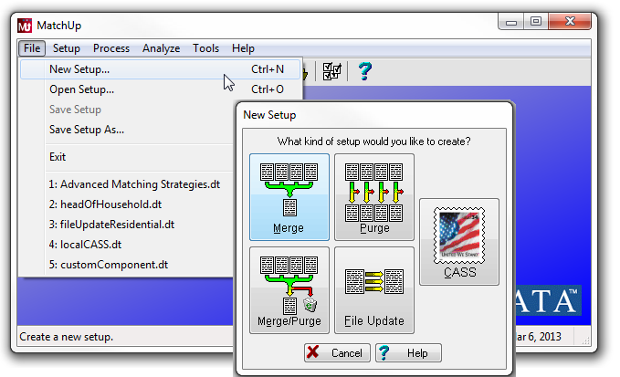
1. Select File > New Setup… from the menu bar
2. Select Merge Purge

Slide 5
These are the steps Necessary to create a Merge Purge Setup we’ll go through…
GENERAL
This is where we specify the rules used to determine if records match
INPUT TABLES
Add database tables to be processed
MATCHCODE MAPPING
Tell MatchUp which columns contain the data needed to compare records
OUTPUT FIELD MAPPING
Configure the desired output structure
OUTPUT TABLES
What type of output table do I want, and where do I place it.
ADVANCED (Optional)

Slide 6
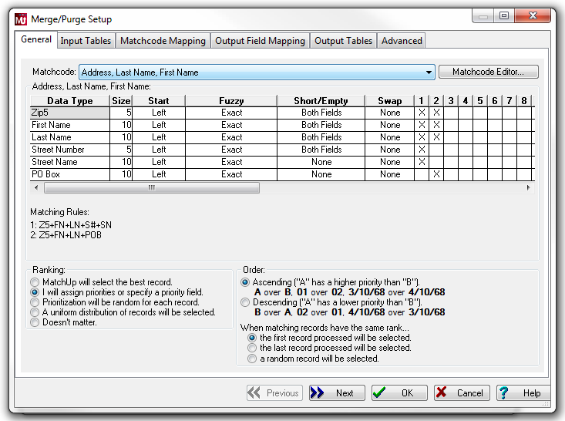
To create a setup, we’ll run through each tab, configuring the setup as we go along
You can select each tab to navigate through the setup or use the Next button to move to the next step.

Slide 7
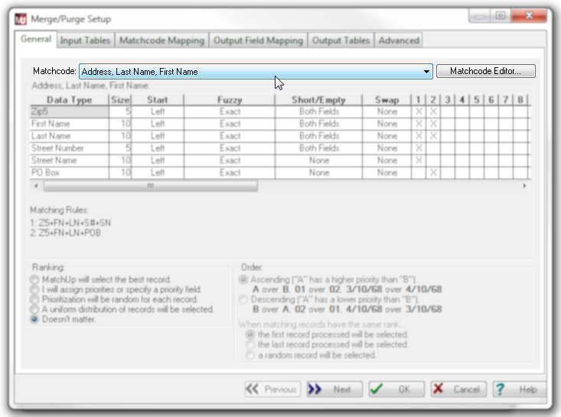
3. Select a Matchcode. This is the name of the rule set which will determine if records match.

Slide 8
If the distributed Matchcodes don’t meet your needs, select the Matchcode Editor to create your own rule set.

Slide 9
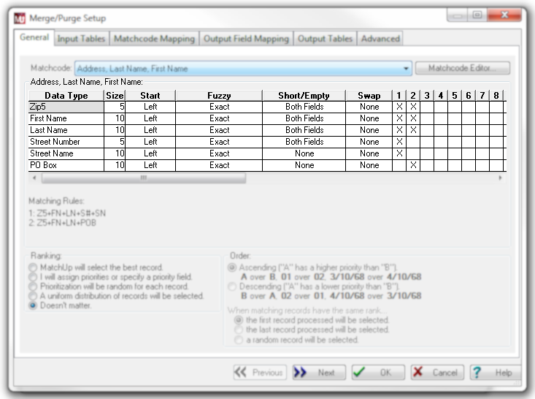
Each Matchcode has a list of components. These are the data types which will be evaluated. Each component has settings which can be individually configured.

Slide 10
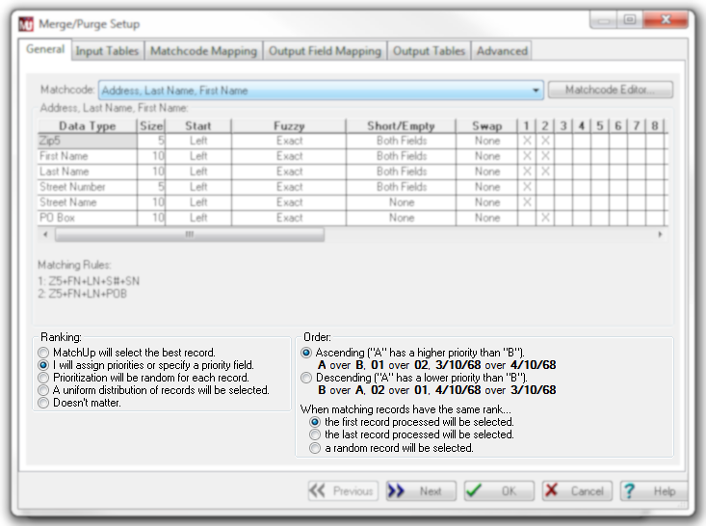
You can set a Ranking if Golden Record selection is important when two records match. We’ll configure the priority on the next screen

Slide 11
After default Ranking has been overridden and Priority is chosen, assign ‘higher’ or ‘lower’ order for record selection.

Slide 12
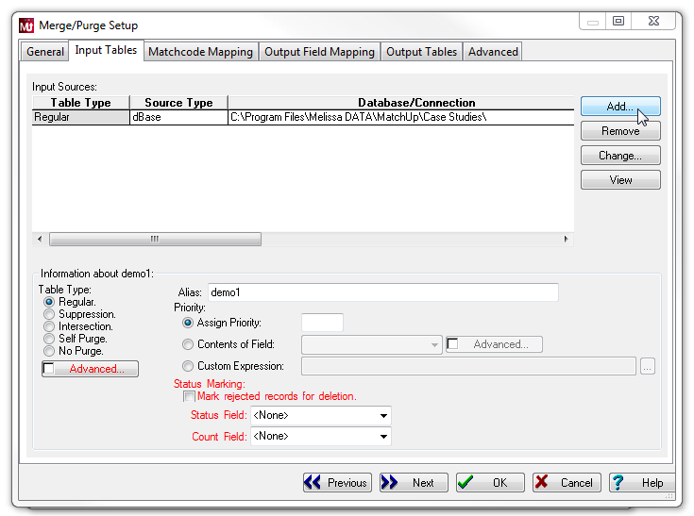
4. Add the source tables to be processed and compared in this setup

Slide 13
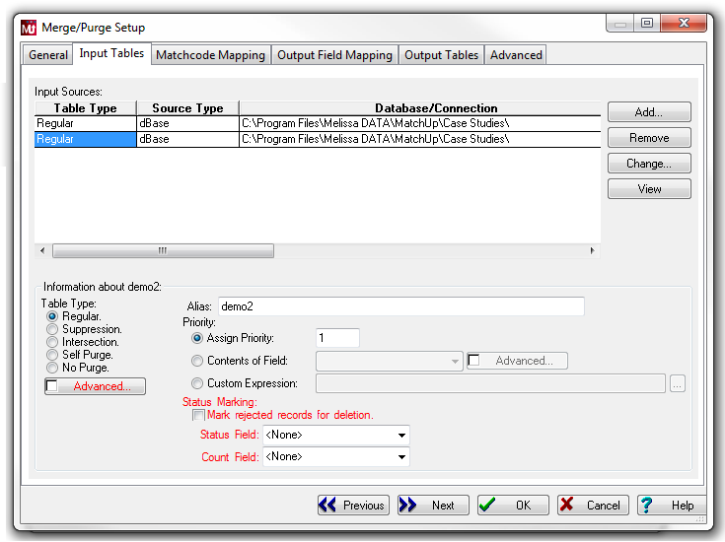
Highlight each source file individually and assign it a priority (if you selected Ranking on the previous step).

Slide 14
The most common usage processes tables as type Regular.

Slide 15
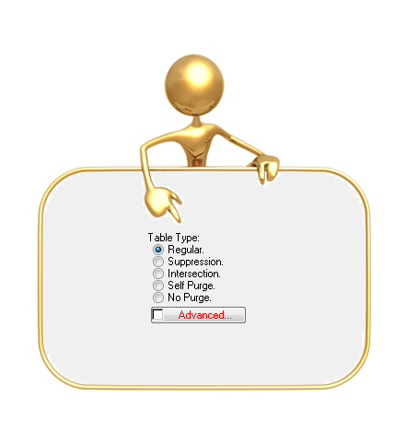
What do these mean?

Slide 16
Table types Intersection and Suppression act as filters – and determine which Regular should be written to output.

Slide 17
Self Purge and No Purge are types of Regular tables – which determine if duplicates should be flagged within or across other Regular files…

Slide 18
Table Types
Input Regular
Input Regular
Output Table
Smith
Smith
Jones
Nelson
Smith
Smith
Nelson
Smith
Nelson
Jones
B1
C
C
Duplicates Table
Smith
Smith
Smith
Nelson
A1
A1
A1
A1

Slide 19
Table Types
Input Regular
Input Intersection
Output Table
Smith
Smith
Smith
Jones
Nelson
Jones
Jones
C1
Duplicates Table
Not Intersected Table
Smith
Smith
Smith
Nelson
E1
E1
E1
E

Slide 20
Table Types
Input Regular
Input Intersection
Output Table
Smith
Smith
Smith
Jones
Jones
Nelson
Jones
Jones
B1
Duplicates Table
Jones
A1
Not Intersected Table
Smith
Smith
Smith
Nelson
E1
E1
E1
E

Slide 21
Table Types
Input No-Purge
Input Intersection
Output Table
Smith
Smith
Smith
Jones
Jones
Nelson
Jones
Jones
Jones
C1
C1
Duplicates Table
Not Intersected Table
Smith
Smith
Smith
Nelson
E
E
E
E

Slide 22
Table Types
Input Regular
Input Suppression
Output Table
Smith
Smith
Smith
Jones
Jones
Nelson
Jones
Smith
Nelson
B1
C
Duplicates Table
Smith
Smith
A1
A1
Suppressed Records Table
Jones
Jones
D1
D1

Slide 23
Table Types
Input No-Purge
Input Suppression
Output Table
Smith
Smith
Smith
Jones
Jones
Nelson
Jones
Smith
Smith
Smith
Nelson
C
C
C
C
Duplicates Table
Suppressed Records Table
Jones
Jones
D1
D1

Slide 24
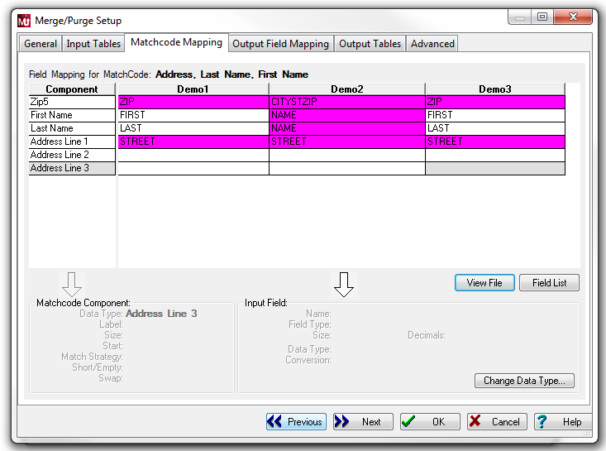
5. For each source file, make sure you map in the table column for each data type required by the matchcode in use.

Slide 25
The exception is Address Line mapping.
Even though most address matchcodes use individual address parts, MatchUp requires one, two or three full address lines

Slide 26
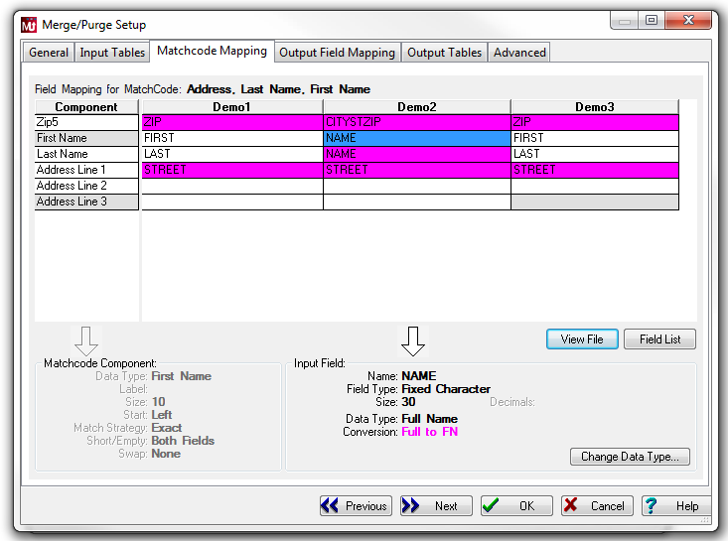
Table columns may have different formats. Make sure MatchUp recognizes if a conversion is necessary

Slide 27
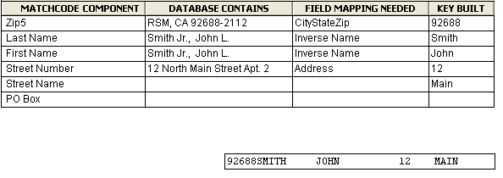
Matchcode Mapping your Data
TIP
The data you process does not have to have the same structure as the required Matchcode components.
MatchUp will extract the necessary data to satisfy your matchcode and build the matchkey correctly

Slide 28
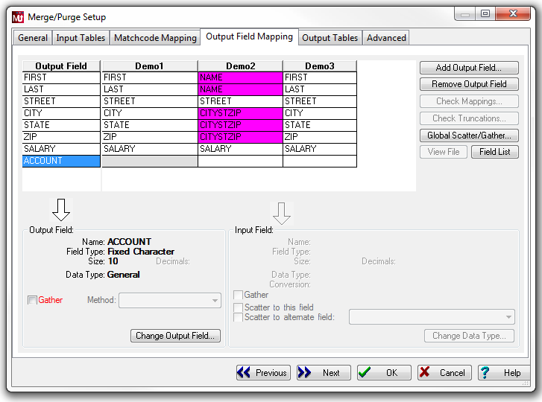
6. Create the desired output structure (for the output table we’ll create on the next tab).

Slide 29
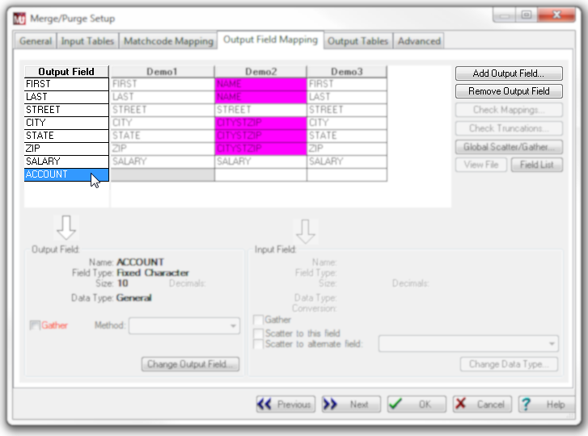
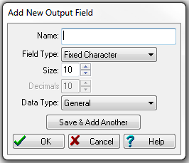
To add or remove columns from the desired output structure, select anywhere in the output column, then select the appropriate button.

Slide 30
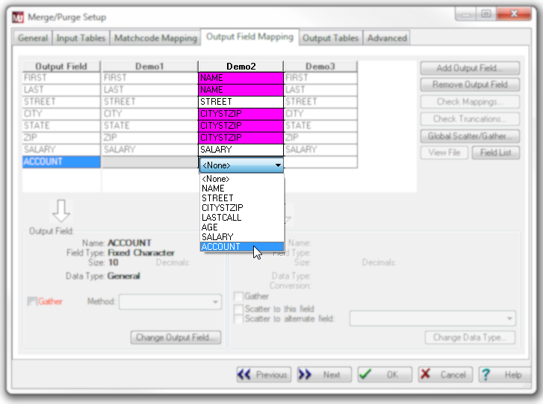
If any of the tables have a column which you want to contribute to the output, and it has not been mapped in, double-click the blank cell and map in the column

Slide 32
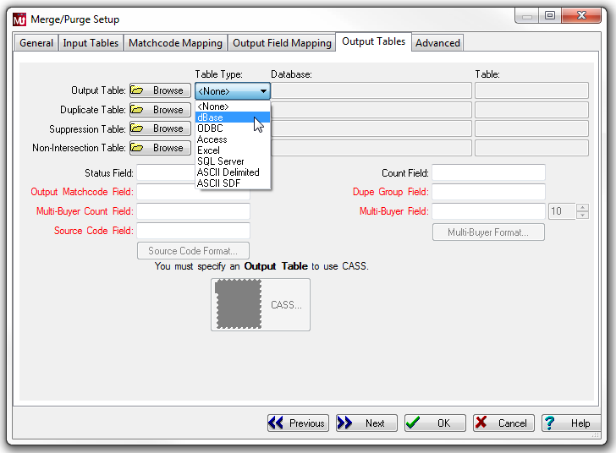
7. To create an Output Table(s), select the Table Type, then Browse – to navigate to the location where the table will be written.
Enter a filename for each output table.

Slide 33
Depending on the source file table types, you may also capture duplicates, suppressed records, or non-intersected records by creating the respective table.

Slide 34
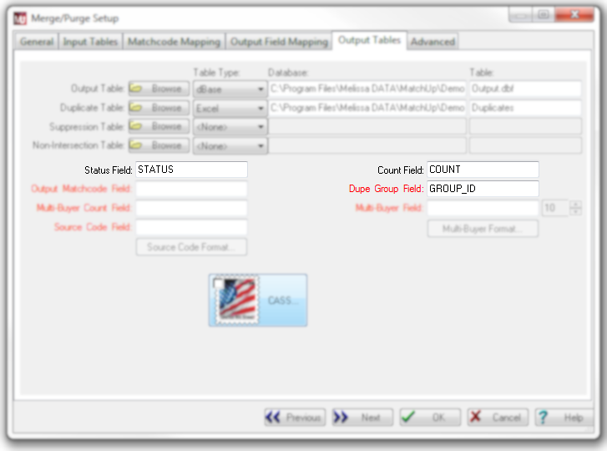
In addition to source data specified on the Output Field Mapping screen, you can write additional fields to the Output Tables.
These are populated with compiled results from the finished process

Slide 35
OUTPUT | GROUP_ID | STATUS | COUNT
Smith | 1 | B | 4
Nelson | 2 | B | 2
Jones | 3 | C | 1
Using a previous example of two regular tables, all records can be written to output tables with a linking GROUP identifier, output disposition (c=unique, b=golden record, a=duplicate, etc), and a group count, for example.
DUPES | GROUP_ID | STATUS | COUNT
Smith | 1 | A | 4
Smith | 1 | A | 4
Smith | 1 | A | 4
Nelson | 2 | A | 2

Slide 36
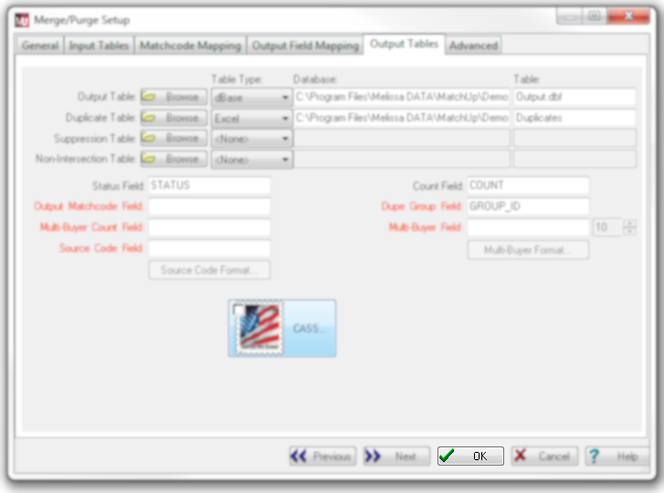
8. Select OK.
Although there are many more advanced concepts not covered here, this completes a basic merge purge setup.
You are ready to process.

Slide 37
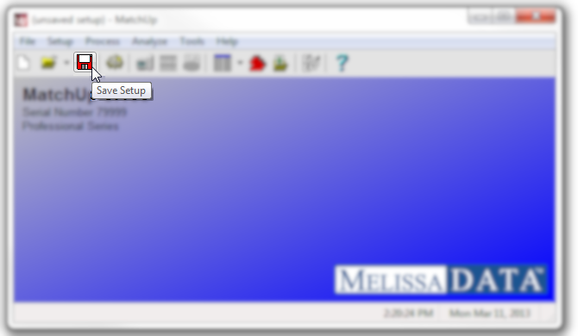
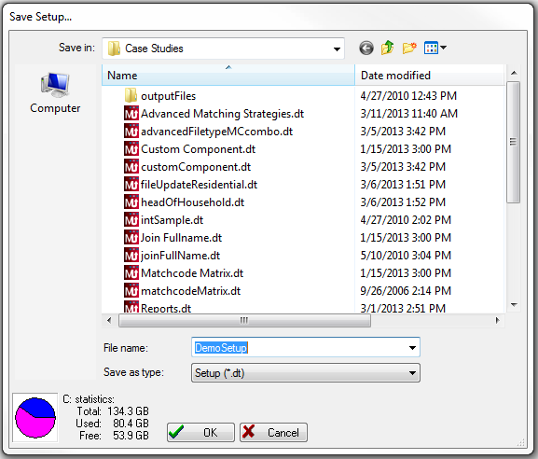
9. Don’t process yet!
We ALWAYS recommend that you save your setup. This allows you to open this file and process this job anytime, or to use this configuration for future jobs.

Slide 38
Process
10. Select Process from the menu bar or the Process icon. Depending on the number of records, setup complexity, and your hardware environment the process may take minutes, or hours.

Slide 39
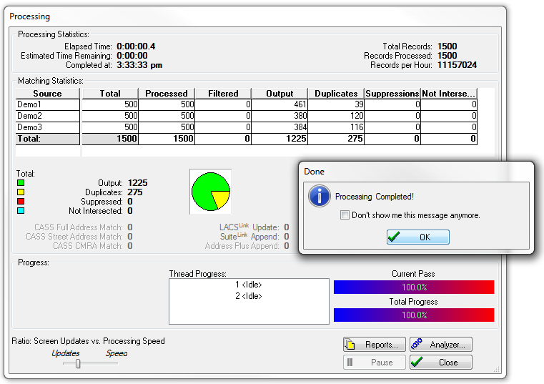
Processing
When the process is done, general statistics are presented, giving you an idea how the process went.

Slide 40
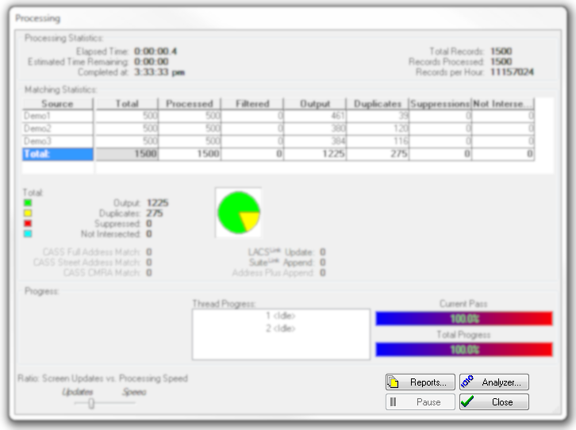
Processing
Select Reports to view or print process summaries and statistics.
If the output seems completely unexpected, select Analyzer

Slide 41
Analyze
The analyzer is the first place for recommended troubleshooting.
For every records’ input data , we can see the constructed matchkey used for comparisons.

Slide 42
Reports
Depending on the setup type, and advanced options, there are 17 different reports to choose from.

Slide 43
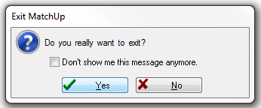
At this point, the output files are already written to your hard drive, there’s no need to Save. You can use ‘Tools > Browse’ or use the source tables’ native data viewer to see the results.
Thank You

Slide 45
Questions?
Thank You for reading this presentation, we hope you found it informative!.
Technical Information | Sales Questions:
Technical Support Melissa Data Corp. tech@MelissaData.com 1-800-635-4772, opt #4 | Sales Department Melissa Data Corp. salesdepartment@MelissaData.com (800) 635-4772 x187
Notes:
Thank the attendees

Slide 46
Additional Resources
Melissa Data Wiki
MatchUp_Overview.pptx
MatchcodeEditor_Overview.pptx
InefficientMatchcode_Analysis.pptx
EditingMatchcodes.pptx (coming soon)

