Slide 1
MatchUp

Slide 2
SSIS MatchUp
Introduction
Advanced Merge Purge with SQL Server Integration Services

Slide 3
Setting up a simple Merge Purge project

Slide 4
From Visual Studio, create a new Integration Services project.

Slide 5
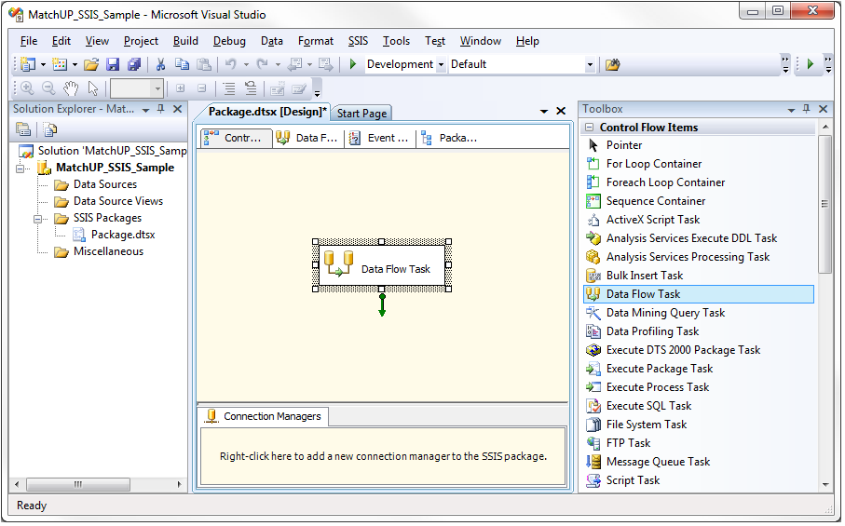
On the Control Flow tab, drag a Data Flow Task from the Toolbox onto the palette.

Slide 6
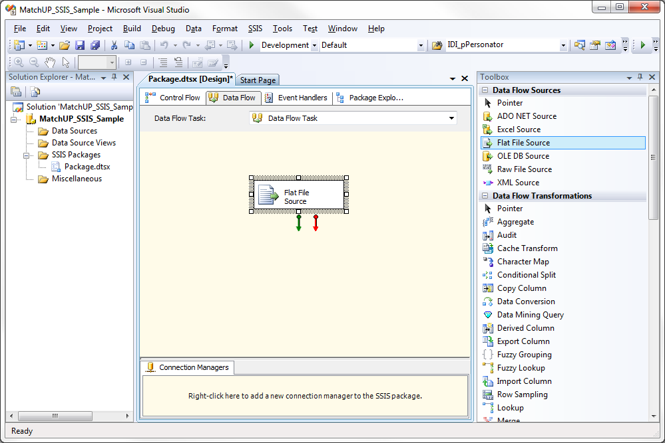
Click the Data Flow tab and select a Data Flow Source

Slide 7
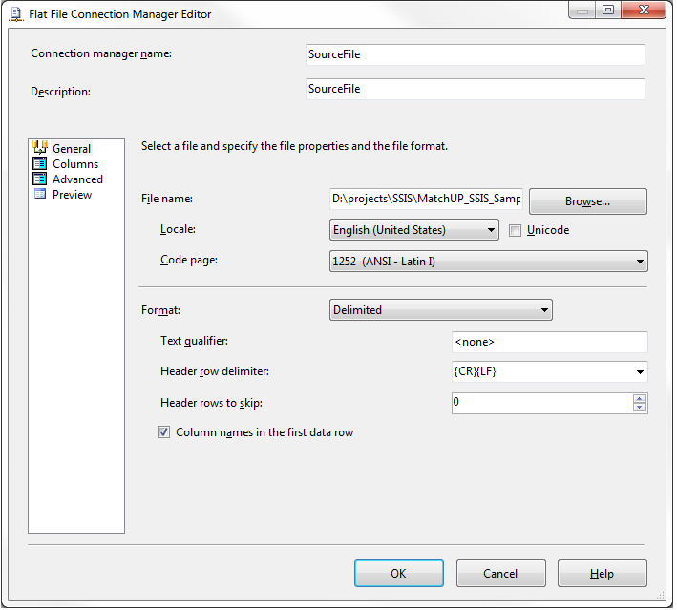
Configure the data source

Slide 8
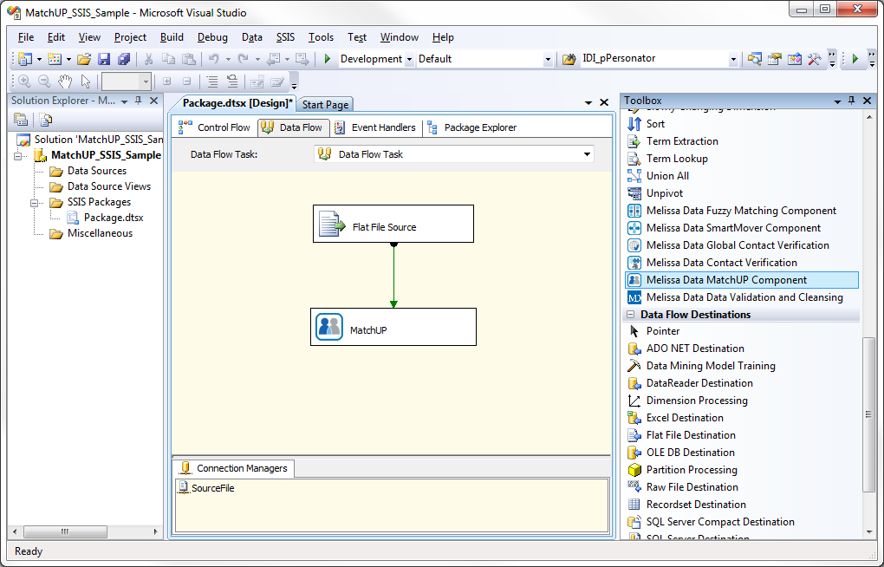
From the Toolbox, select the MatchUP Component and drag it onto the palette. Connect the Source output pin to the MatchUP Component.

Slide 9
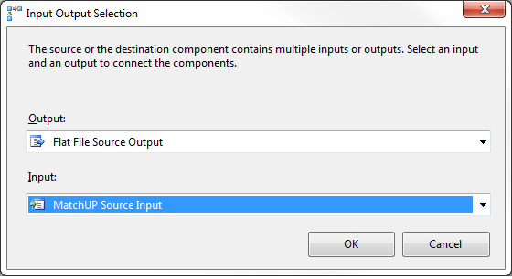
For a single table, choose MatchUP source Input

Slide 10
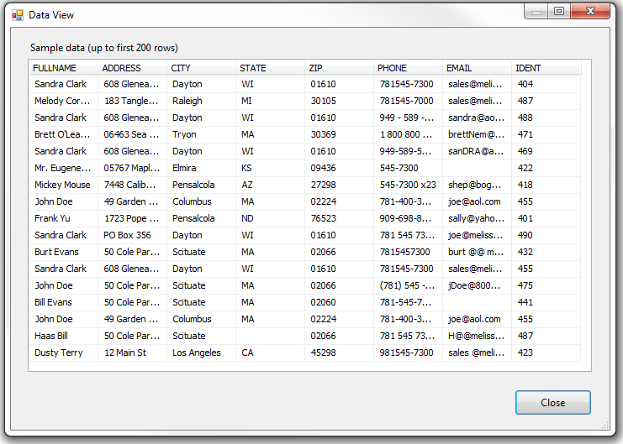
Sample data set…

Slide 11
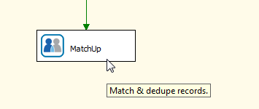
Configuring the MatchUP Component
Double-clicking the component will bring you to the setup screen.

Slide 12
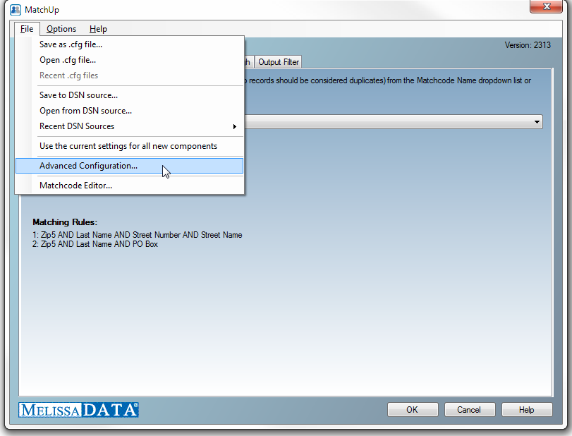
If you did not provide a valid license during installation, or want to reconfigure the component, from the menu, select File > Advanced Configuration

Slide 13
Enter your license string. Then select Test Configuration to test the license string.

Slide 14
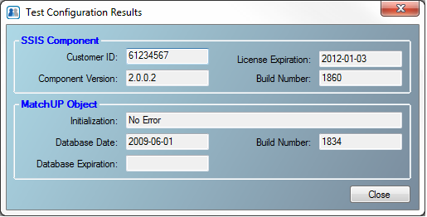
In addition to being able to retrieve properties of the component, you can verify that the component is configured correctly and is ready to be setup.

Slide 15
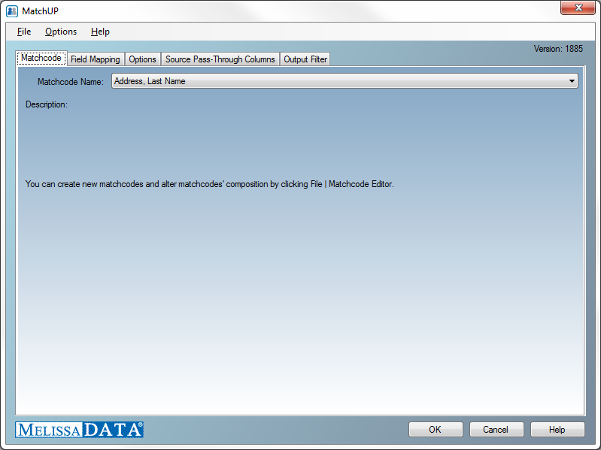
We’re ready to configure the MatchUp component…

Slide 16
These are the steps necessary to configure MatchUp we’ll go through…
MATCHCODE
This is where we specify the rules used to determine if records match
FIELD MAPPING
Tell MatchUp which columns contain the data needed to compare records
OPTIONS
Specify Golden Record Selection and processed information about the disposition of a record
SURVIVORSHIP /
PASS-THROUGH
Configure the desired output structure
LOOKUP / PASS-THROUGH (Optional)
Configure the optional second input source
OUTPUT FILTER
Determine which records to stream to available output pins.

Slide 17
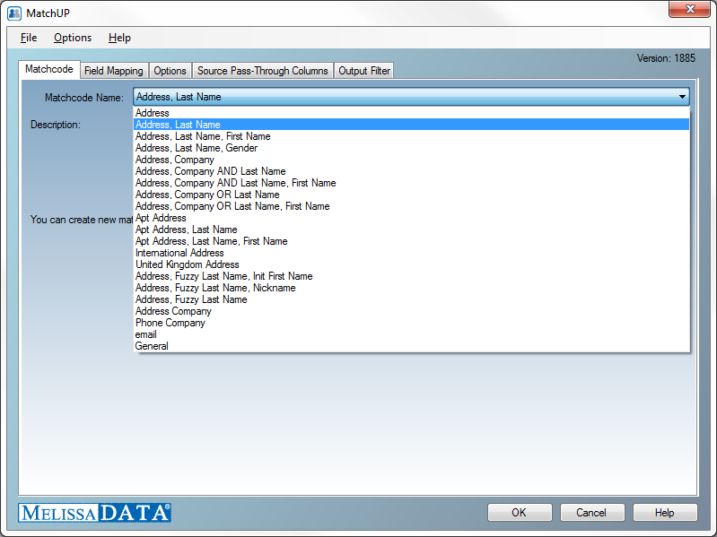
Select your matchcode from the dropdown list. This is matching criteria which will be used to determine if records are duplicates.
First, we select a Matchcode, the matching strategy which will be used to compare records for this project.

Slide 18
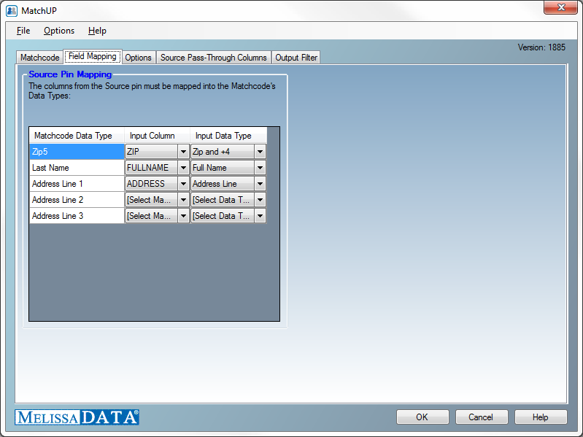
For each component that the selected matchcode uses, map in the source column – which will provide the data to be evaluated for matches

Slide 19
The format of the incoming data also needs to be specified

Slide 20
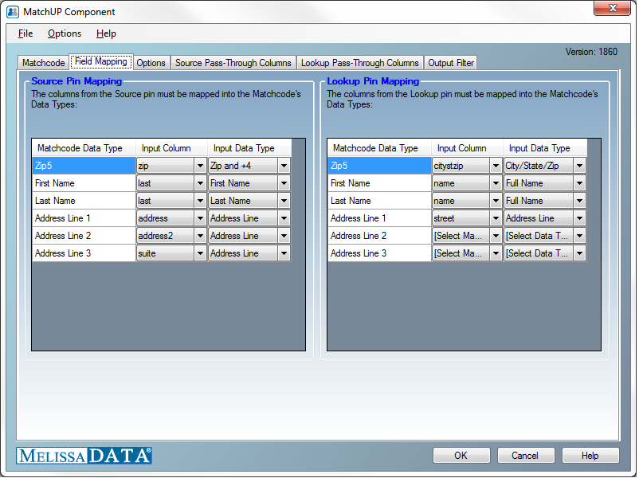
Advanced: MatchUP allows you to add a second table as an input

Slide 21
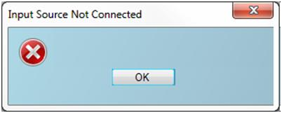
Advanced NOTE: Source Pin Mapping Warning
These are the mappings for the table which is used to provide the records which will be deduped for output. For a single table process, this pin is required. If you try to configure the component with a single upstream source mapped into the Lookup pin, you will get an error.
Lookup Pin Mapping
These are the mappings for the table used as a filter when matched against Source pin records. The Options tab allows you to specify whether only the Source records matching Lookup records (intersected) will be output, or whether these matches will be suppressed from the output. When there is only a single upstream source connected to the MatchUP component, this section will not be visible.

Slide 22
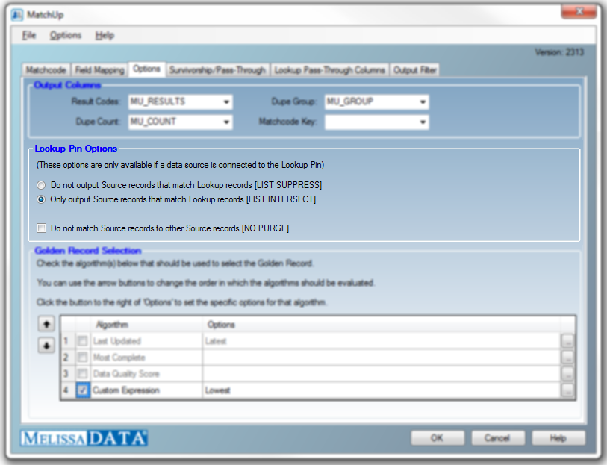
Specify whether the optional Lookup stream should be used as suppression or intersection filter

Slide 23
Advanced: Examples of Lookup Pin Options
Input Lookup
Intersection
Input Source
Output Stream
Smith
Smith
Smith
Jones
Nelson
Jones
Jones
Jones
Jones
MS02
Duplicates Stream
Jones
Jones
MS03
MS03
Not Intersected Stream
Smith
Smith
Smith
Nelson
MS05
MS05
MS05
MS05
23
MS31

Slide 24
Advanced: Examples of Lookup Pin Options
Input Source No-Purge
Input Lookup
Intersection
Output Stream
Smith
Smith
Smith
Jones
Nelson
Jones
Jones
Jones
Jones
Jones
Jones
MS01
MS01
MS01
Duplicates Stream
Not Intersected Stream
Smith
Smith
Smith
Nelson
MS05
MS05
MS05
MS05
24
MS31

Slide 25
Advanced: Examples of Lookup Pin Options
Input Lookup Suppression
Input Source
Output Stream
Smith
Smith
Smith
Jones
Nelson
Jones
Jones
Jones
Smith
Nelson
MS02
MS01
Duplicates Stream
Smith
Smith
MS03
MS03
Suppressed Records Stream
Jones
Jones
Jones
MS04
MS04
MS04
25
MS30

Slide 26
Advanced: Examples of Lookup Pin Options
Input Source No-Purge
Input Lookup Suppression
Output Stream
Smith
Smith
Smith
Jones
Nelson
Jones
Jones
Jones
Smith
Smith
Smith
Nelson
MS01
MS01
MS01
MS01
Duplicates Stream
Suppressed Records Stream
Jones
Jones
Jones
MS04
MS04
MS04
26
MS30

Slide 27
On the Options tab, configure the Component to output disposition, number of records in each matched group, and the unique group identifier

Slide 28
When a group of records are found to match, you can create a criteria to determine which record will be selected as the output record

Slide 29
One click away is the expression builder, giving you easy and unlimited ways to create the desired Golden Record order

Slide 30
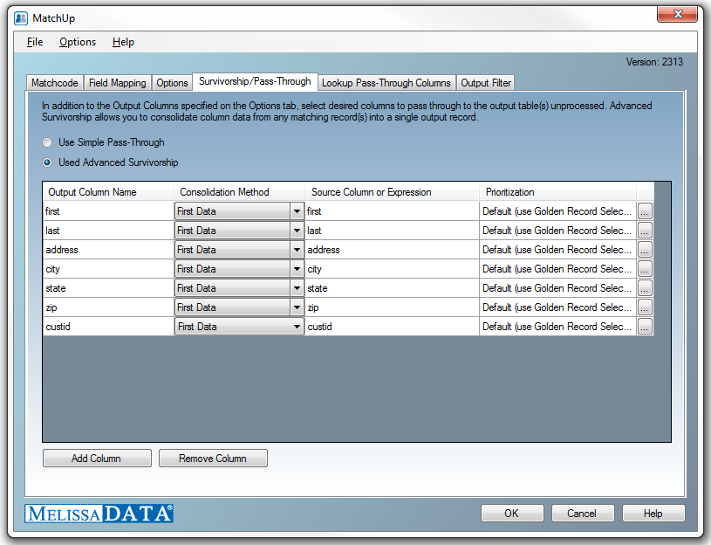
You can select to stream original source data to the output, or configure Advance Survivorship – field by field data priority or consolidation

Slide 31
Each column can be individually configured to determined which piece of data from one of the matching records will be consolidated

Slide 32
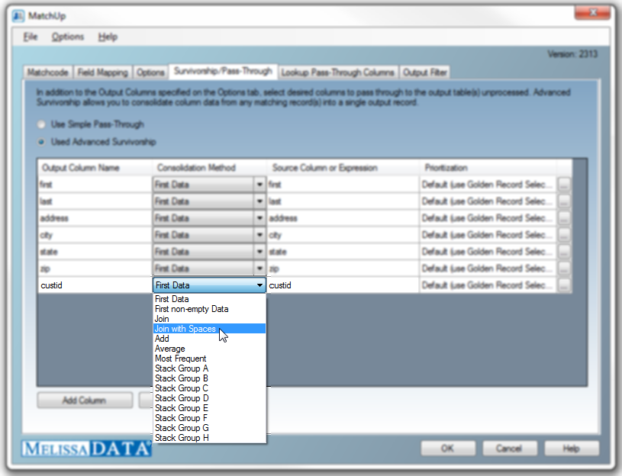
Select the method in which the consolidation will be determined…

Slide 33
The expression builder will help you create rules for data consolidation priority

Slide 34
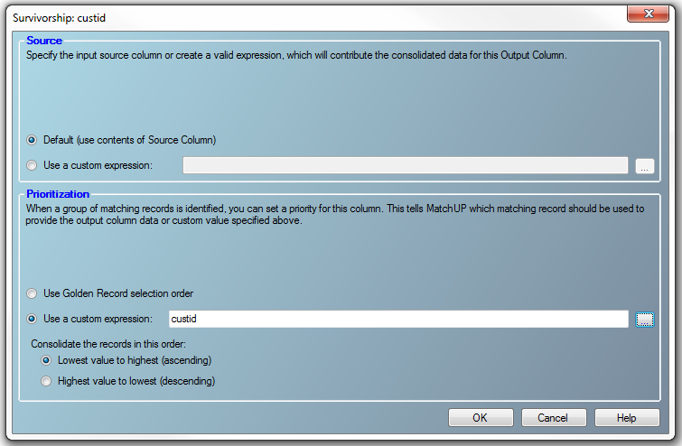
Specify the source of data which you want consolidated into the Survivorship output

Slide 35
Once you’ve configured the data to be consolidated, configure the order of priority for those values

Slide 36
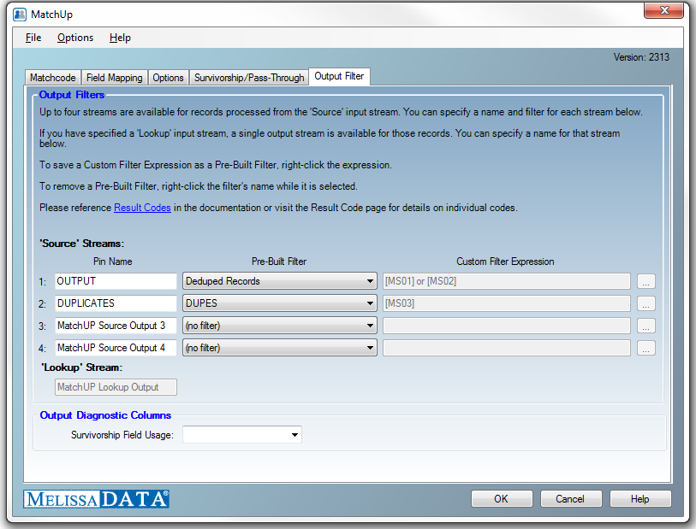
The component gives you four available output pins to stream the results

Slide 37
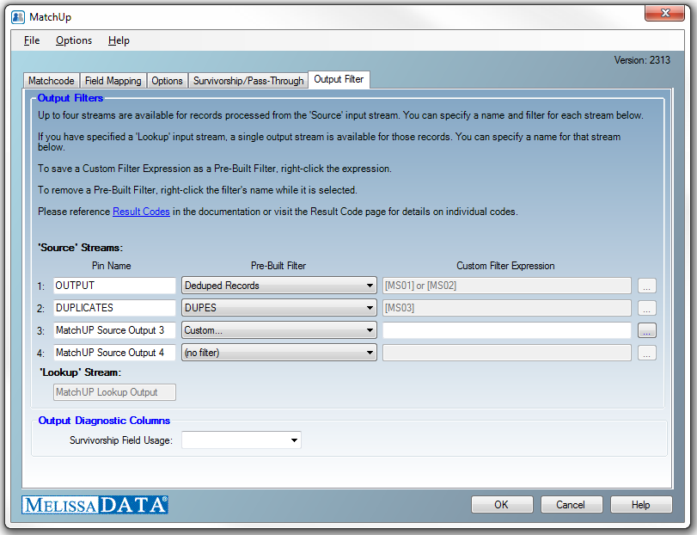
If you require more advanced output criteria than the basic Pre-Built Filters for output records and duplicates, select the builder button to create custom stream rules

Slide 38
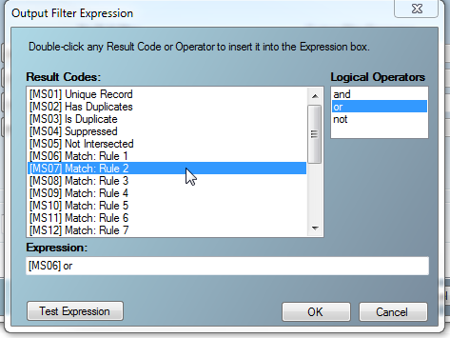
These custom rules can be used to create separate output streams for different output disposition, or matchcode combinations.

Slide 39
Examples of Filter Expressions
[MS01] or [MS02] A unique record or group winner – a common expression used
to obtain a ‘clean’ output list.
[MS03] and [MS06] A record which was found to be a duplicate because it matched
on combination (rule) 1.
[MS01] and [MS03] A unique record and a duplicate (!?!). This is a valid expression,
but not logically possible. A record can not be both, so this would
not send any records down the respective stream.
[MS04] and [MS08] Records which were suppressed by rule number 3. Suppressed
perhaps by name and email, or name and company, etc.

Slide 40
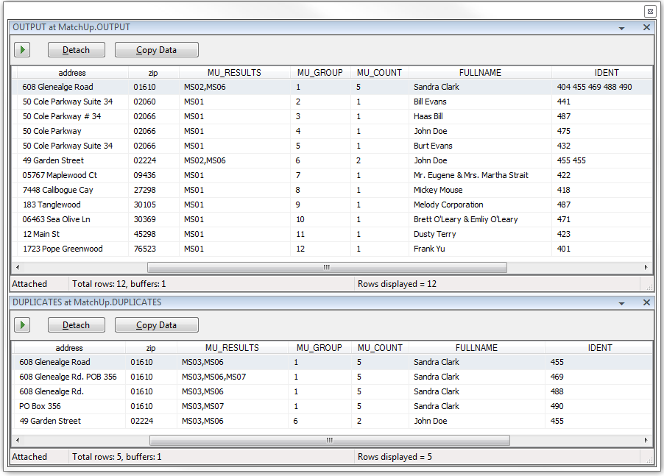
After saving the setup and processing, MatchUp determines which records are duplicates, and streams them to the configured output pin

Slide 41
The output records are marked a distinct Result Code for unique records and group winners

Slide 42
A unique GROUP identifier makes it easy to locate records found to be matched, while the COUNT tells you how many records are in the group

Slide 43
Our Golden Record selection determined which record was selected for output. Survivorship gathered the Idents for matching records

Slide 44
Questions?
Thank You for reading this presentation, we hope you found it informative!.
Technical Information | Sales Questions:
Technical Support Melissa Data Corp. tech@MelissaData.com 1-800-635-4772, opt #4 | Sales Department Melissa Data Corp. salesdepartment@MelissaData.com (800) 635-4772 x187

Slide 45
Additional Resources
Melissa Data Wiki
MatchUp_Overview.pptx
MatchcodeEditor_Overview.pptx
InefficientMatchcode_Analysis.pptx
EditingMatchcodes.pptx (coming soon)

Slide 46
Thank You !

