Slide 1
MatchUp Web Service

Slide 2
MatchUp Web Service
Introduction
Advanced Deduping Made Easy for Developers

Slide 3
Distribution Options
 | MatchUp Windows Desktop | MatchUp Object | MatchUp ETL | LWXL MatchUp | MatchUp Web Service
Matchcode Editor | x | X | x
Programming required |  | x |  |  | x
Multi Platform |  | x
Real Time - Deduping |  | x
Flexible output (File type) | Various file types |  | Various file types
Record Limit | unlimited | Unlimited | unlimited | 50000 | unlimited
Global processing? | US, CAN, UK | Global | Global | presently no | presently no
Output record Consolidation | gathering |  | survivorship
Output record priority | priority |  | golden record
source record update (distribute) | scattering
Rapid Development | x |  | x
Rapid Integration |  |  | x | x
direct file handling | x |  | x | Excel, csv, etc.
unlimited files | X |  | Source, lookup
analyzing | built in tool |  |  | x
file control toolset | x
CASS | x
Automatic reports generated | 18 reports |  |  | X
updates |  | x | x | x | automatic
support | x | x | x | x | x

Slide 4
MatchUp Web Service is Versatile
Rapid application development made easy for any language platform protocol combination that can call a web service

Slide 5
Identifying Duplicates
?
?
?
?
How do I set the rules for determining whether two records match or not?
How do we match differently formatted records?
Query
Match ?
Smith Jr., John Accounting Services, Inc. 12 Main St Anytown, CA 92688
Mr. J Smithe TAXman Consulting Suite 5 12 North Main Street Anytown, CA 92688

Slide 6
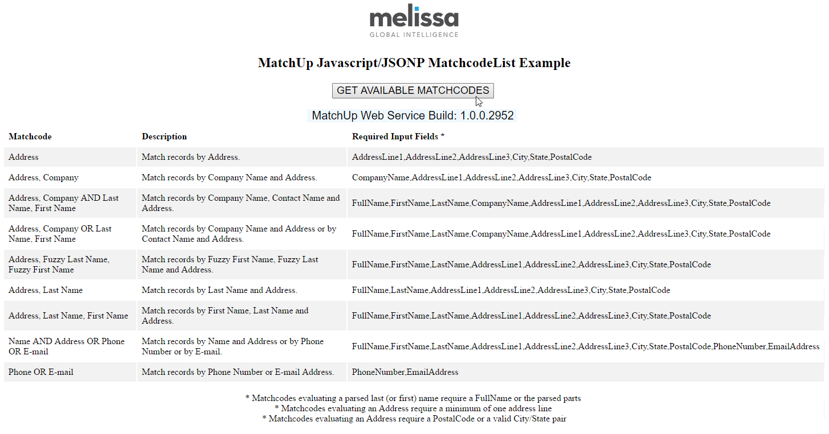
call GetMatchcodeList for available matchcodes…

Slide 7
MatchUp Web Service is Easy
Installation
There are no libraries or data files to maintain.
Just your licensed Customer ID and a service endpoint is needed to get started
INSTALLATION
Rapid Development
It ‘can’ be as easy as sending sample requests through your browser (see documentation for examples)
DEVELOPMENT
Resources
Online documentation and DevConsole, support and knowledgebase content keep you up and running with no downtime.
RESOURCES

Slide 8
Other Melissa Services…
Send records…

Slide 9
Other Melissa Services…
Retrieve results…

Slide 10
Other Melissa Services…
Send records…

Slide 11
Other Melissa Services…
Retrieve results…

Slide 12
Other Melissa Services…
Send records…

Slide 13
Other Melissa Services…
Retrieve results…

Slide 14
Other Melissa Services…
Send records…

Slide 15
Other Melissa Services…
Retrieve results…

Slide 16
MatchUp Web Service…
Send records…

Slide 17
MatchUp Web Service…
Send records…

Slide 18
MatchUp Web Service…
Send records…

Slide 19
MatchUp Web Service…
Send records…

Slide 20
MatchUp Web Service…
When all records are sent, processing is done.
RECORDS
SUBMITTED
PROCESS
GET JOB
STATUS

Slide 21
MatchUp Web Service…
Retrieve results…

Slide 22
MatchUp Web Service…
Retrieve results…

Slide 23
MatchUp Web Service…
Retrieve results…

Slide 24
MatchUp Web Service…
Retrieve results…

Slide 25
Results
Like other MatchUp solutions, the results are returned in the form of output properties which tell a particular records relation to other records

Slide 26
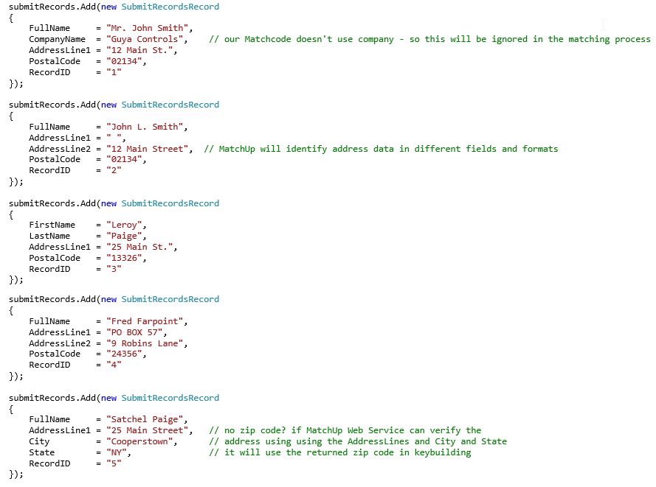
Example JSON Input

Slide 27
Sample Output Properties

Slide 28
MatchUp OBJECT Order of Operations
INITIALIZE
read database
BUILD KEY
STORE KEY
DEDUPE
READ RESULTS
group output record
duplicates

Slide 29
MatchUp Web Service Order of Operations
GET MATCHCODELIST
CREATE JOB REQUEST
read database
SUBMIT RECORDS
SUBMIT JOB
GET JOB STATUS
RETRIEVE RECORDS
group output record
duplicates

Slide 30
MatchUp Web Service is a good option for…
“I need to call from an environment or language which MD doesn't support”.
Ex. nodeJS customers – currently we don’t distribute wrapper libraries for our Objects
“Can be integrated into an application where a service can be called, but linking to our library and datafiles is not easy.”
Ex: CRM integration where hosting libraries and data files is problematic.
Ex: An updated OS, DBMS or IDE might produce compatibility issues.
Ex: Everything is done in the cloud.
“Advanced Options are not important, we just need to link matching records”.
Ex: Group records but Golden Record / Survivorship is unnecessary.
“We don't require advanced matchcodes.”
Ex: Group records under basic match types

Slide 31
Deduping Considerations
Most Melissa Data Objects are record based
i.e. a record is passed to the API and it returns results pertaining to that record
MatchUp (deduping) returns results based on other records processed
i.e. the results of the first record can not be returned until all keys are built (and compared)
Complex rule sets (matchcodes) can make processing slower and even return false dupe groupings
Use caution in creating your matching strategy and test thoroughly before implementing in a production environment

Slide 32
Savings Benefits
Sending duplicate mail pieces to customers and prospects is costly
Cut printing and production costs by eliminating producing unnecessary mail pieces
Reduce the negative image to customers/prospects who might otherwise receive multiple mail pieces
Telemarketers lower long distance charges and reduce the negative image to customers/prospects who might otherwise receive multiple calls

Slide 33
Savings Benefits
Time.
Setup time required to implement reduces repetitive manual labor.
MatchUp is very fast. Eliminate the need for dedicating processors for days to dedupe your database.

Slide 34
Data Quality Benefits
Resolve / Update outdated records, tables or entire databases
Record linkage output properties allow for easy grouping of matched records

Slide 35
Data Quality Benefits
Cleans outdated records, tables or entire databases
The most common MatchUp task is to identify and remove duplicate records

Slide 36
Data Quality Benefits
Maintain / Monitor outdated records, tables or entire databases
Prevent point of entry redundant database records
Store record matchkey and output disposition properties for future evaluation

Slide 38
Thank You !

